Slide 1
Variables in Python

Slide 2
What is a variable
A variable is a piece of memory set aside in RAM to store data. Data can be numbers, strings (of letters), single characters, True/False, or combinations of the above.
Variables are used to store important data that you want to track throughout your program

Slide 3
Parts of a Variable
All variables have 3 main parts:
The variable name is the keyword used to identify the location in memory
The variable's value is the actual data the variable is currently storing.
The variable type tells Python how to interpret the data stored

Slide 4
Variable Types
int (for integer)‏
stores whole numbers (no decimals).
float (for floating point)‏
stores numbers with decimals.
str (for strings)
stores a sequence of 0 or more characters
bool
stores either the keyword True or False

Slide 5

Declaring Variables
Python automatically allocates storage space each time a new variable is created.
Python determines a variable type based on the data assigned to it
Python has tools to convert data from one type to another (more on this later)

Slide 6
Modifying Variables
Once a variable is declared, it exists for the life of the program. (Python does allow you to delete variables if you need to)
You can change the value of a variable at any point in your program by using the assignment (=) operator.
Example
n = 12 # n is a new int variable and is assigned the value 12
n = n * 3 # n is now 3 times its old value (n = 36)
n = ‘thirty’ # n is now a string with the value ‘thirty’

Slide 7
Accumulator operators
Python supports special operators: +=, -=, *=, /=, //=, %=, **= which modify the left-hand variable by the right-hand amount
Example
r = 17.5 # r is a new float variable and assigned the value 17.5
r += 32 # r is increased by 32. r = 49.5
r -= 27.25 # r is decreased by 27.25. r = 22.25
r *= 2 # r is now twice its old value. r = 44.5
r /= 5 # r is now 1/5 its old value. r = 8.9

Slide 8
Conventions
All variable names will begin with a lower-case letter followed by 0 or more letters, numbers, or the underscore ( _ )‏ and never end with an underscore
Variable names should be descriptive (i.e. the name of the variable should indicate what the data it stores represents)
All newly declared variables will have a brief comment after it
Variable names will never replace keywords or built-in functions like print or max

Slide 9
Conventions
Good variable names
m, n, x, y, z, (etc)‏ -- for casual/temporary data
a1, a2, a3, a4, ... -- for related sequences of data
price, total, count, num_baseballs, stockValue, wordLength – for variables that store meaningful data

Slide 10
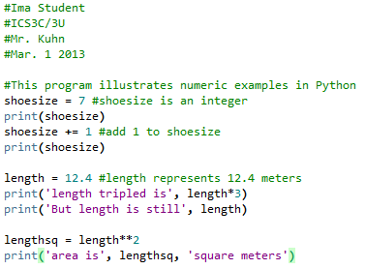

Numeric Examples

Slide 11
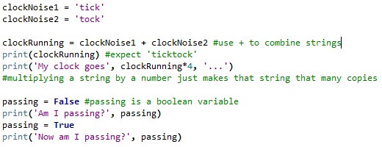

Non-numeric examples

